Slide 1
Kokam 75 Ah NMC-Gr Aging
For Sunpower (2015-2017)
Published in ACC 2017 proceedings
10.23919/ACC.2017.7963578

Slide 2
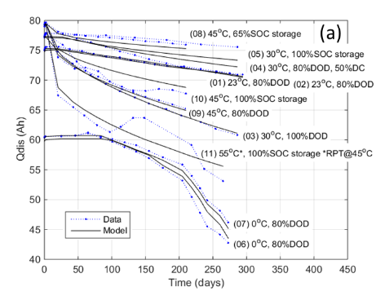
Test matrix
Testing protocol
All cells at beginning of life
  5x C/5 cycles
  HPPC
  RPT: 1x C/5 cycle, HPPC
Calendar aging cells: charge to SOC, rest at open-circuit
Cycle aging cells: CCCV cycling with rests
RPTs every 3 weeks
5x C/5
HPPC
RPT
Cycling

Slide 3
Cell_01 – Cycling: 23 °C, 80% DOD, 92% SOC_{max} (replicate with cell_02)

Slide 4
Cell_02 – Cycling: 23 °C, 80% DOD, 92% SOC_{max} (replicate with cell_01)

Slide 5
Cell_03 – Cycling: 30 °C, 100% DOD

Slide 6
Cell_04 – Cycling: 30 °C, 80% DOD, 92% SOC_{max} (50% duty cycle)

Slide 7
Cell_05 – Calendar: 30 °C, 100% SOC

Slide 8
Cell_06 – Cycling: 0 °C, 80% DOD, 92% SOC_{max} (replicate with cell_07)

Slide 9
Cell_07 – Cycling: 0 °C, 80% DOD, 92% SOC_{max} (replicate with cell_06)

Slide 10
Cell_08 – Calendar: 45 °C, 65% SOC

Slide 11
Cell_09 – Cycling: 45 °C, 80% DOD, 92% SOC_{max}

Slide 12
Cell_10 – Calendar: 45 °C, 100% SOC

Slide 13
Cell_11 – Calendar: 55 °C, 100% SOC (RPT @ 45 °C)

